Slide 1



Art integrated activity…

Slide 2
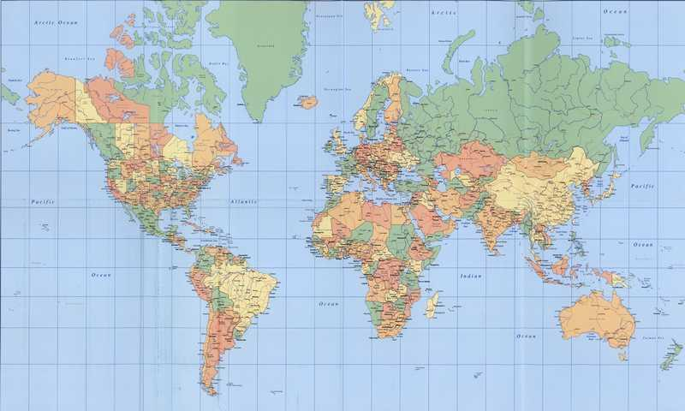
Your best quote that reflects your approach… “It’s one small step for man, one giant leap for mankind.”
Name - Tanisha Subject – social studies
Class – 9th lotus subject teacher - mr. anil chilana
Roll no. – 38 (art integrated activity on Haryana and Telangana)

Slide 3
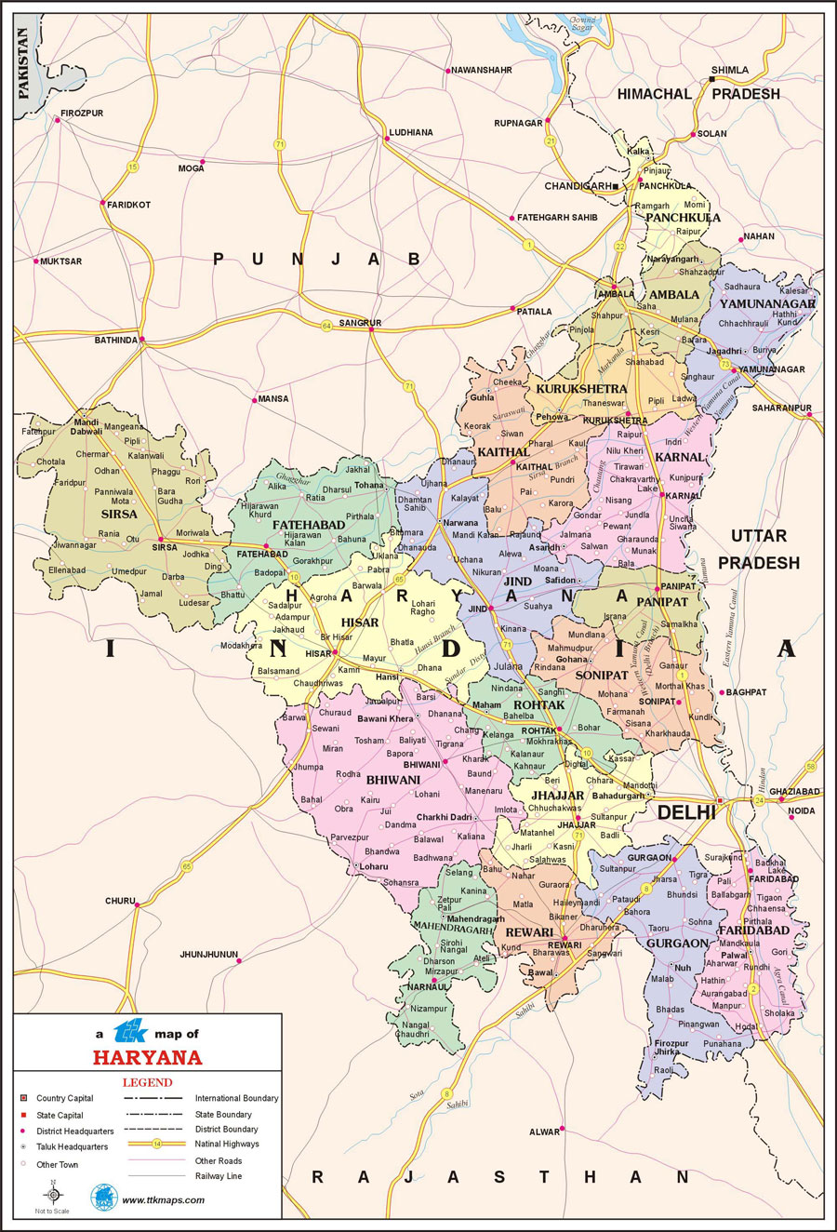

Slide 4
Haryana – formation and physical features
Haryana is a state in India located in the northern part of the country. It was carved out of the former state of East Punjab on 1 November 1966 on a linguistic basis. It is ranked 22nd in terms of area, with less than 1.4% (44,212 km² or 17,070 sq mi) of India's land area. Chandigarh is the state capital, Faridabad in National Capital Region (NCR) is the most populous city of the state, and Gurugram is a leading financial hub of the NCR, with major Fortune 500 companies located in it. Haryana has 6 administrative divisions, 22 districts, 72 sub-divisions, 93 revenue tehsils, 50 sub-tehsils, 140 community development blocks, 154 cities and towns, 6,848 villages, and 6,222 villages panchayats..

Slide 5
Natural vegetation of Haryana
Eucalyptus trees are planted along the highways and in wastelands.
Shisham (Dalbergia sissoo) trees grow along the roads and canals in the northern half of the state.
Small, Spiny kikar (Acacia arabica) trees and scrub are found in southern and southwestern Haryana.

Slide 6
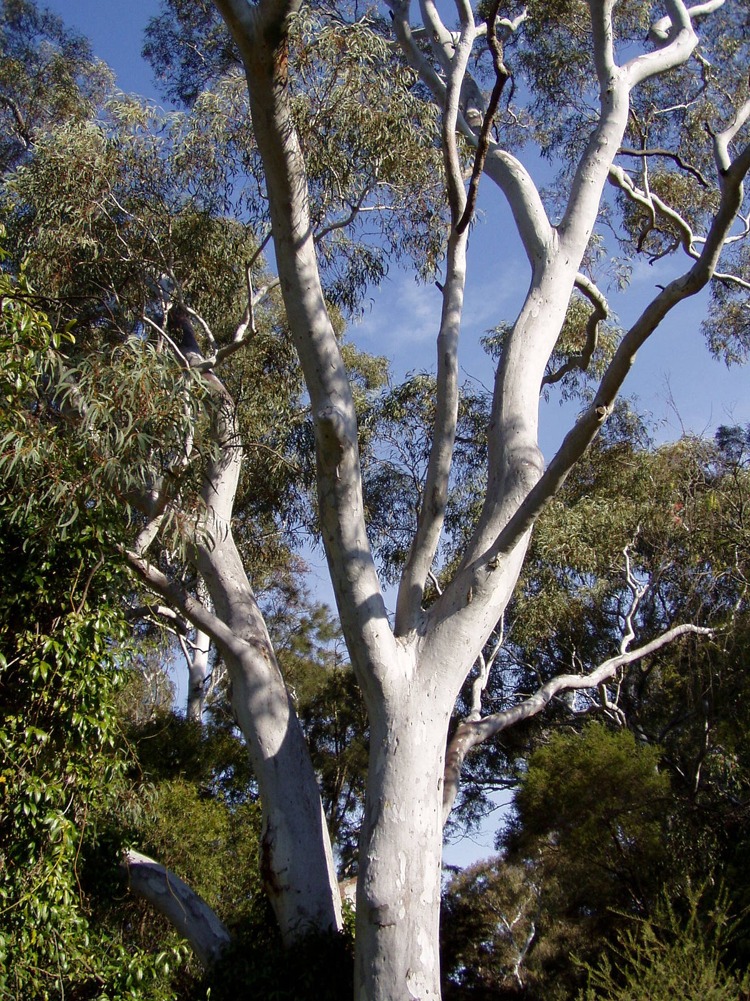

EUCALYPTUS TREE…

Slide 7
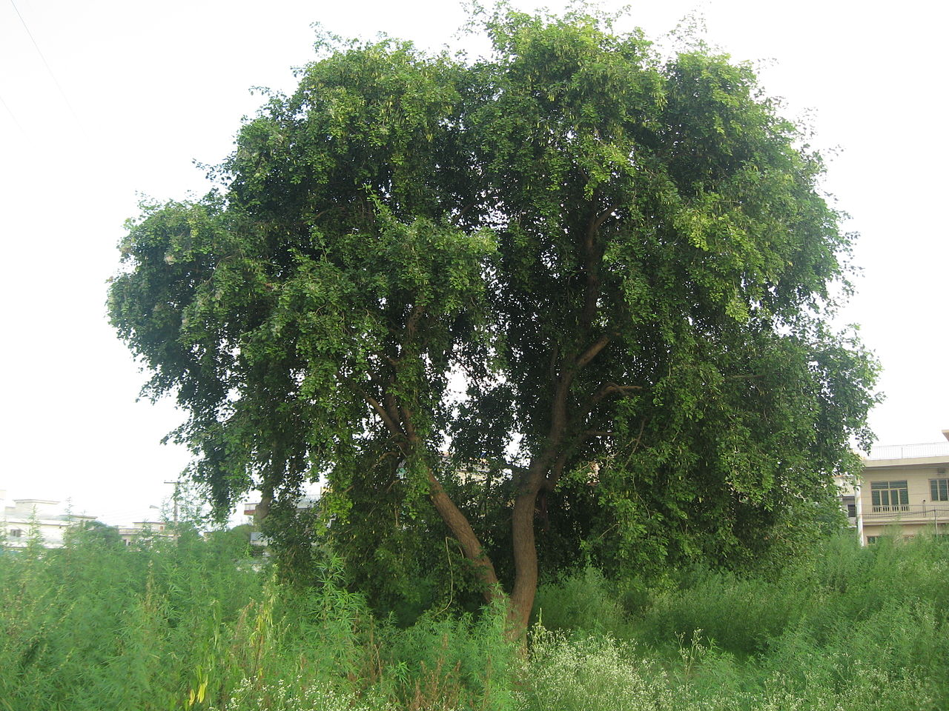
Shisham (Dalbergia sissoO)…

Slide 8
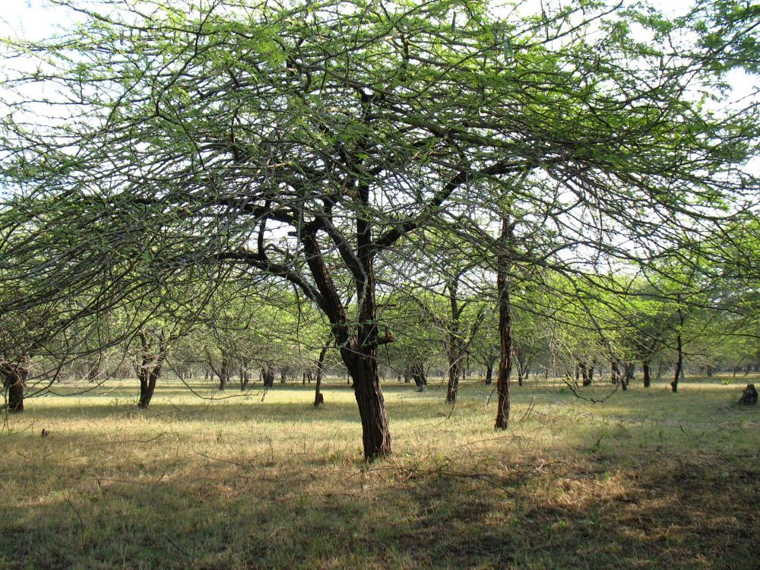
Kikar (acacia arabica)…

Slide 9
Wildlife of Haryana…
Haryana is home to a variety of mammals. Larger species, including leopards, jackals, wild boars, and several types of deer, among others, are generally limited to the hilly regions of the northeast and the far south. Small mammals, such as bats, squirrels, mice, rats, and gerbils, are common in the plains. Ducks and teals of various sorts are found near the rivers. Pigeons and doves are common in the agricultural areas, as are small, colourful birds such as parakeets, buntings, sunbirds, bulbuls, and kingfishers. Several species of snakes are found in the state; among these are pythons, boas, and rat snakes, as well as poisonous kraits and vipers. Other reptiles, including various lizards, frogs, and tortoises, also inhabit Haryana.

Slide 10
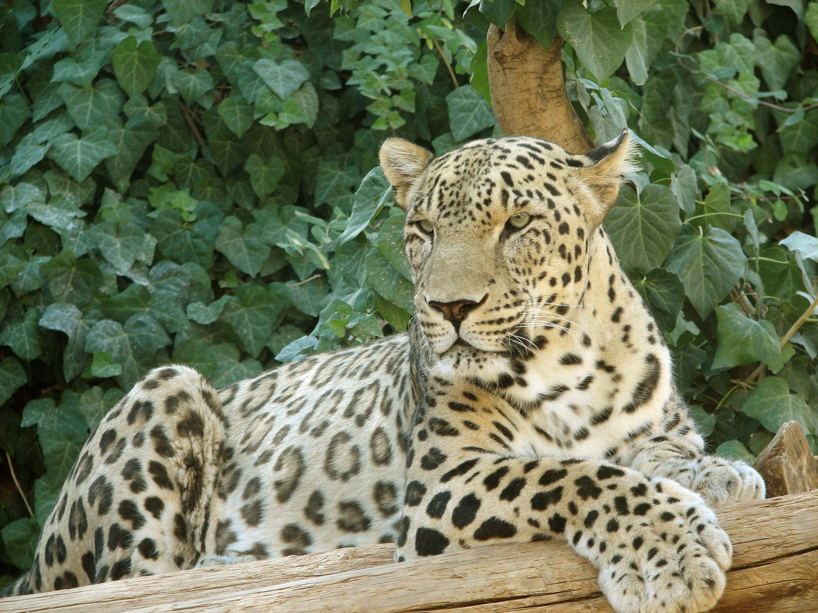
Leopard…

Slide 11
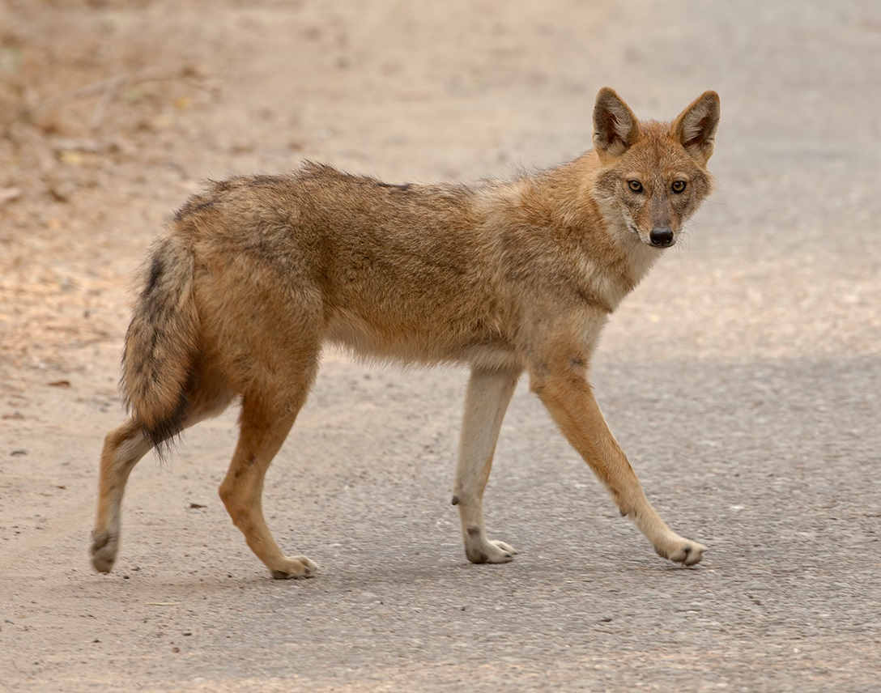
Jackal…

Slide 12
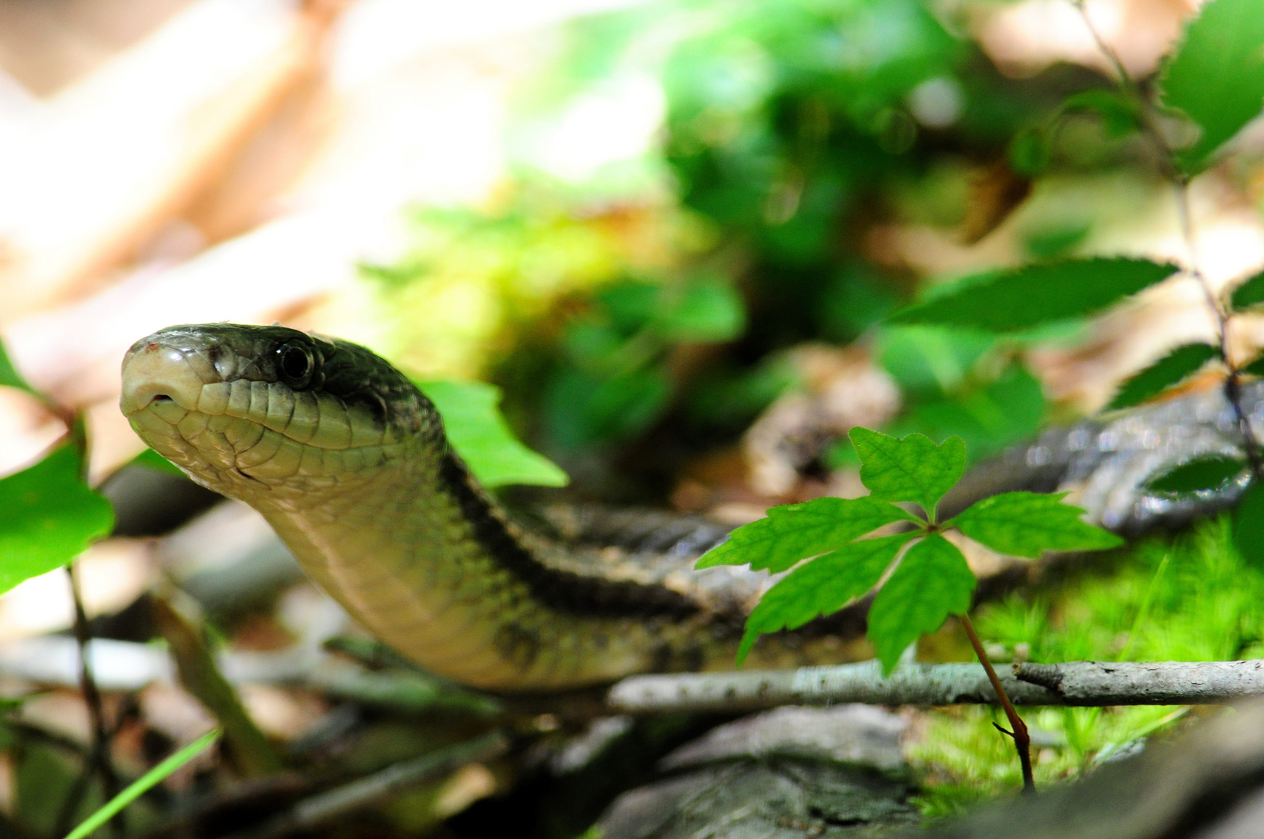
Snake…

Slide 13
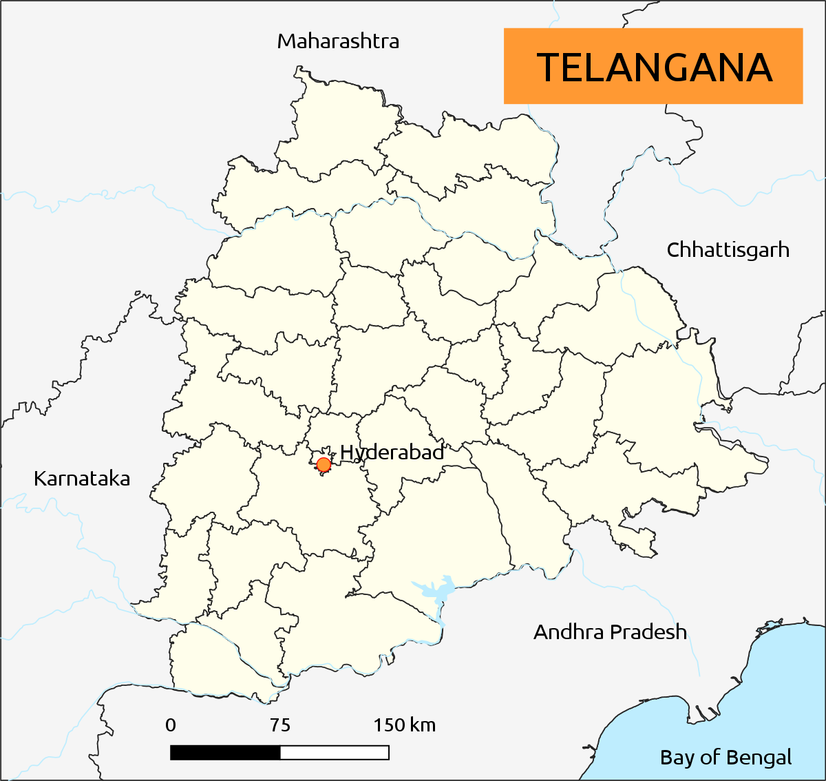

Slide 14
Telangana – formation and physical features
Telangana is a state in Southern India situated on the south-central stretch of the Indian peninsula on the high Deccan Plateau. It is the eleventh-largest state and the twelfth-most populated state in India with a geographical area of 112,077 km² (43,273 sq mi) and 35,193,978 residents as per 2011 census. On 2 June 2014, the area was separated from the northwestern part of Andhra Pradesh as the newly formed state with Hyderabad as its capital. Its other major cities include Warangal, Nizamabad, Khammam, Karimnagar and Ramagundam. Telangana is bordered by the states of Maharashtra to the north, Chhattisgarh to the east, Karnataka to the west, and Andhra Pradesh to the east and south. The terrain of Telangana region consists mostly of hills, mountain ranges, and thick dense forests covering an area of 27,292 km² (10,538 sq mi). As of 2019, the state of Telangana is divided into 33 districts.

Slide 15
Natural vegetation of Telangana
Telangana has a moist deciduous forest. In these forest trees like sandalwood, rosewood, teakwood, bamboo are found...
The plains are also found with trees like mango, neem, and Mahogany…..
The state receives water from the Krishna river basin, making the state rich in vegetable cultivation.

Slide 16
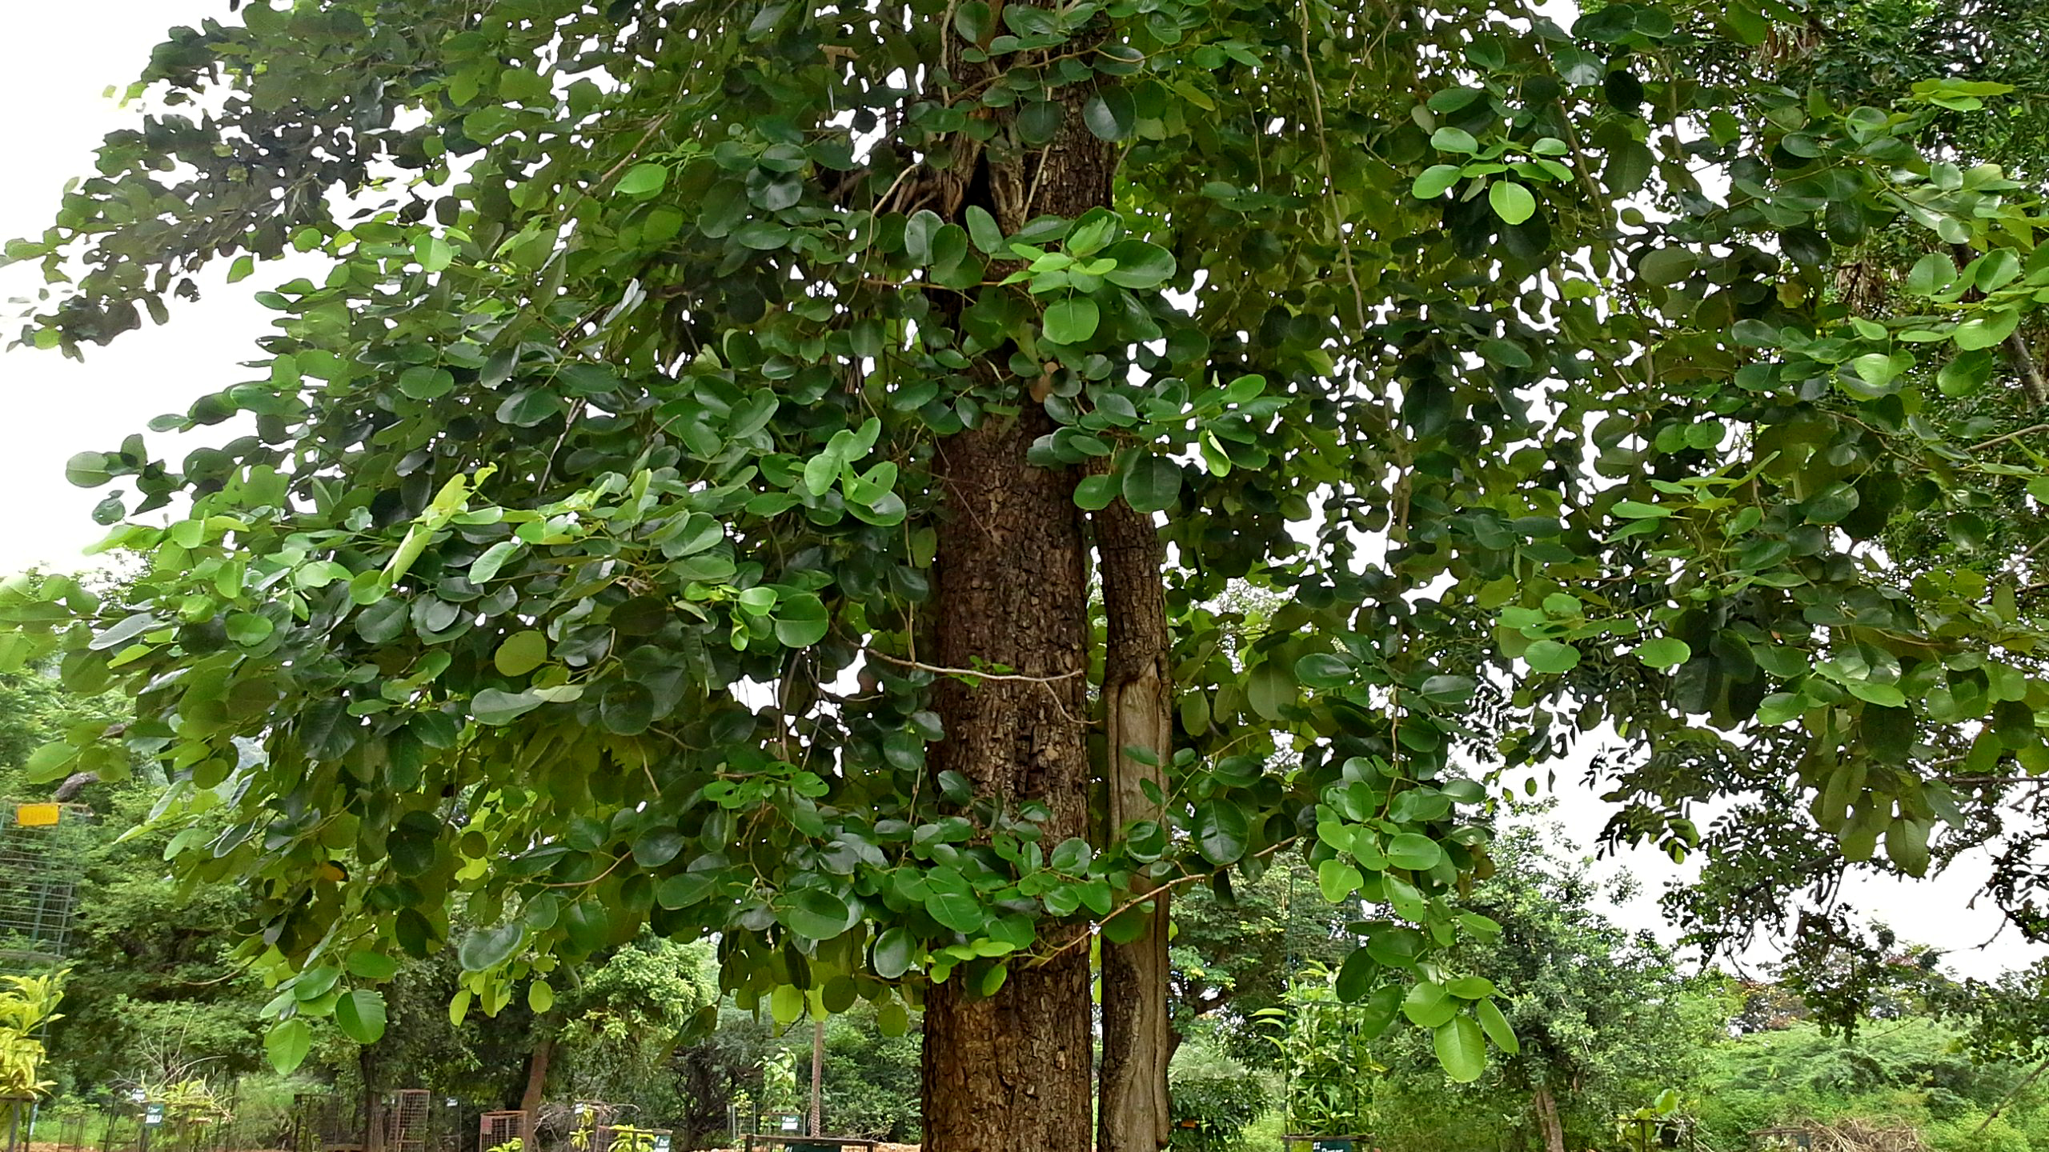
Sandalwood tree…

Slide 17
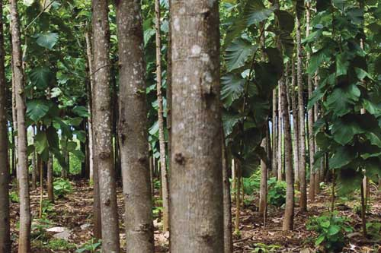
Teakwood tree…

Slide 18
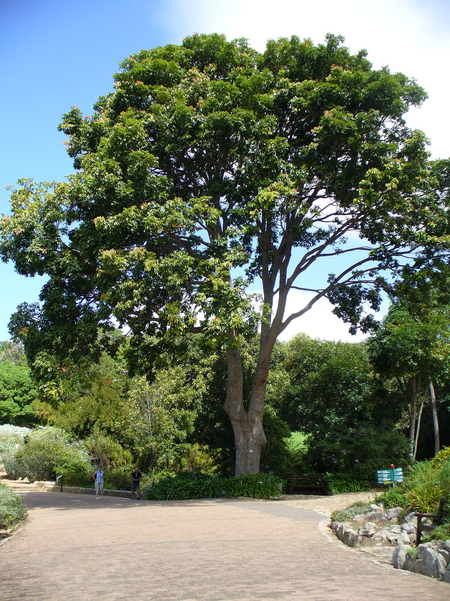
Mahogany….

Slide 19
Wildlife of Telangana….
Telangana State is rich with 108 species of mammals that include Tiger, Leopard, Sloth Bear, Giant Squirrel, Hyena, Fox, Wild Dog, Wild Boar, Indian Bison (Gaur), Spotted Deer, Barking Deer, Black Buck, Four-horned Antelope, Blue Bull, Sambar, Mouse Deer, Honey Badger, Civets , Jungle Cats, Otter, Pangolin, Bats, Tree Shrew, Common Langur , etc.

Slide 20
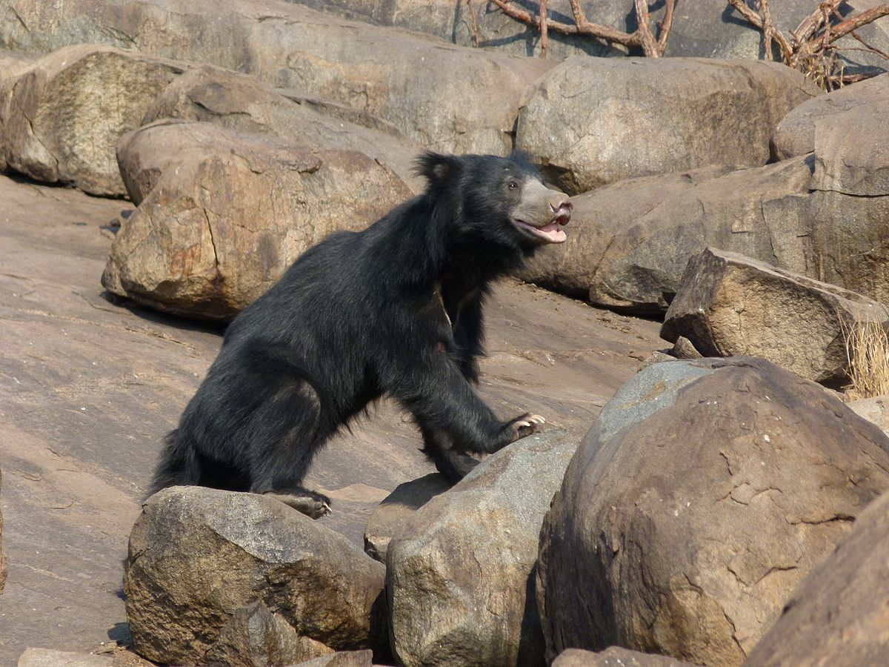
Sloth bear…

Slide 21
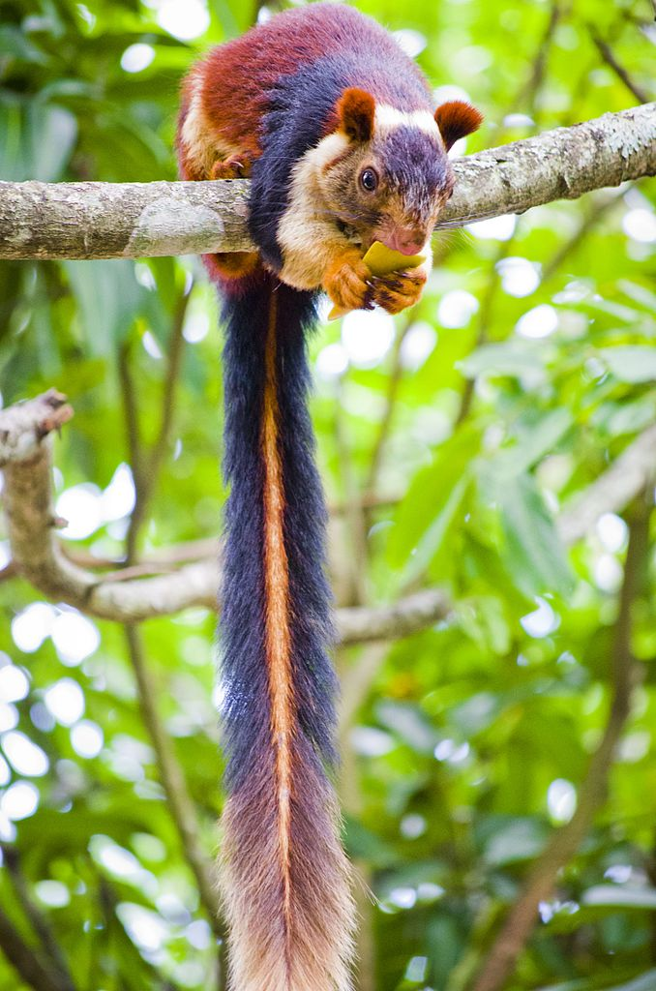
Giant squirrel….

Slide 22
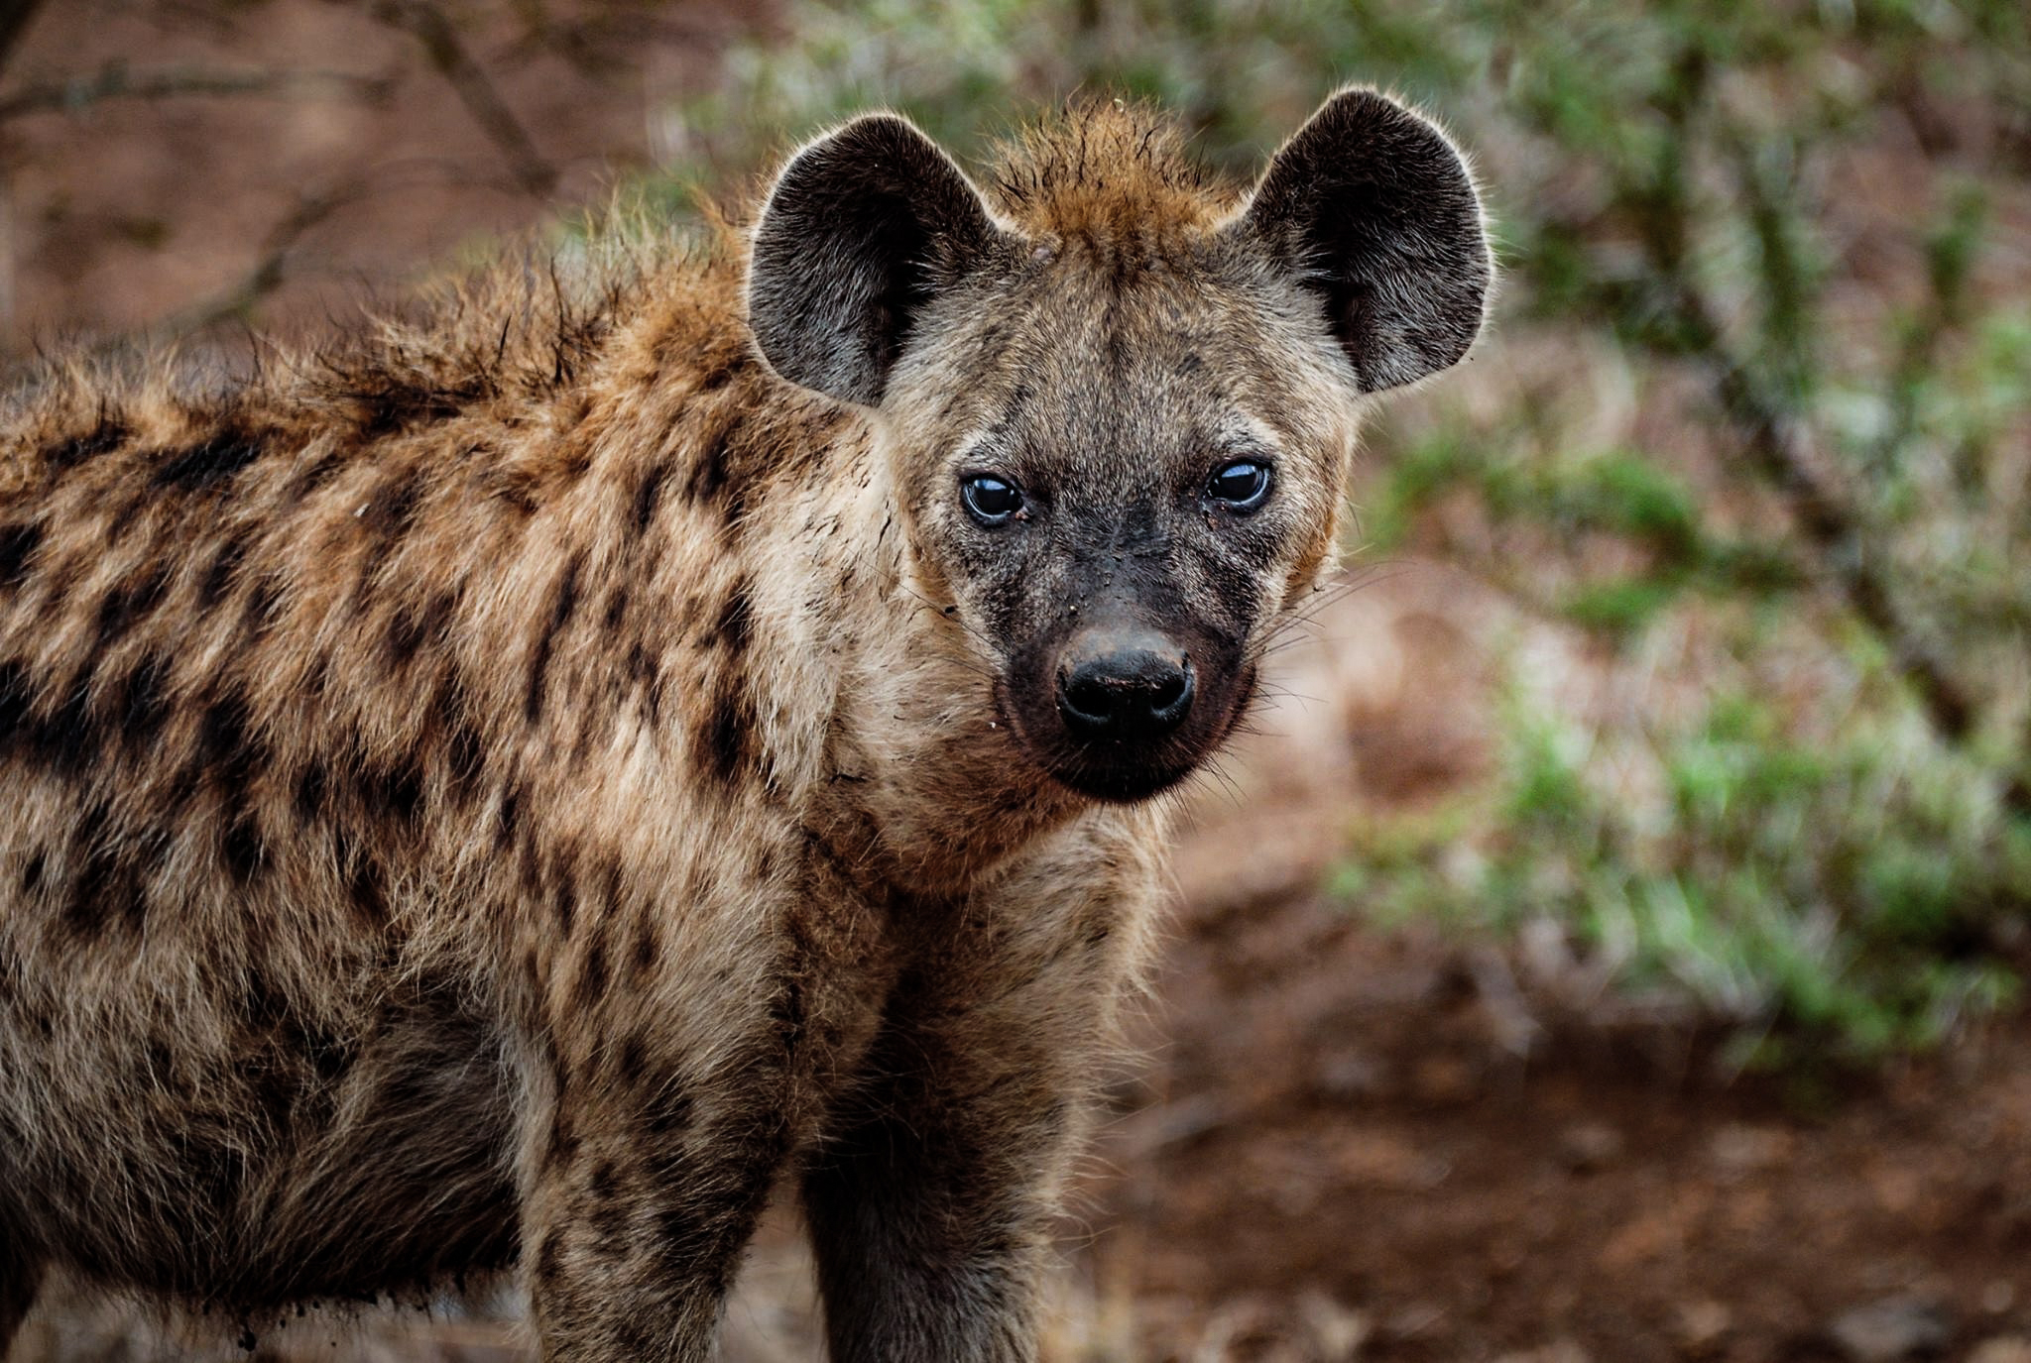
Hyena…

Slide 23


